Slide 1

Incremental Validity
Dr Oliver Clark

Slide 2
Incremental Validity
How much more do we learn about a predicted behaviour if we include more measures in our battery?
Established using Multiple Regression Techniques
R^2 stops dramatically increasing as you add uninformative variables

Slide 3
Incremental validity
Outcome
Variable 2
Variable 1
No incremental validity

Slide 4
Incremental validity
Outcome
Variable 2
Variable 1
High incremental validity

Slide 5
Incremental validity
Outcome
Variable 2
Variable 1
Low incremental validity

Slide 6
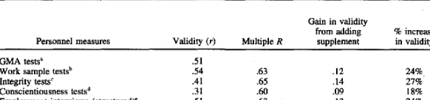
Back to Schmidt & Hunter (1998)

Slide 7
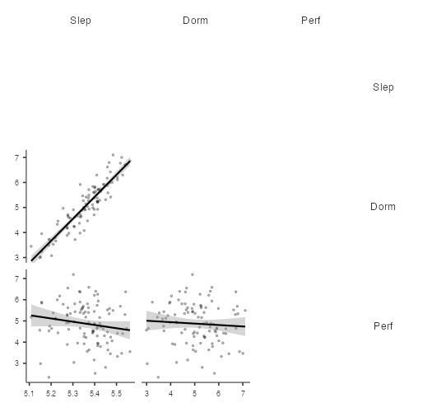
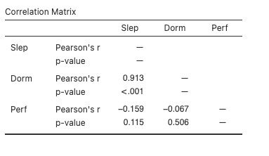
DOPISDO Example

Slide 8
DOPISDO Example
Dormaus and Perfectionism both correlate to some extent with Sleep
But do we learn anything new when we include both Perfectionism and Dormaus to a regression model?

Slide 9
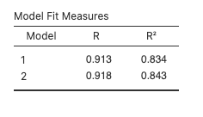
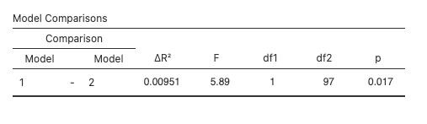
Incremental Validity
We learn about an extra 1% of the variation in sleep

